Slide 1

Terminology
Revision – 2022-09-31

Slide 2
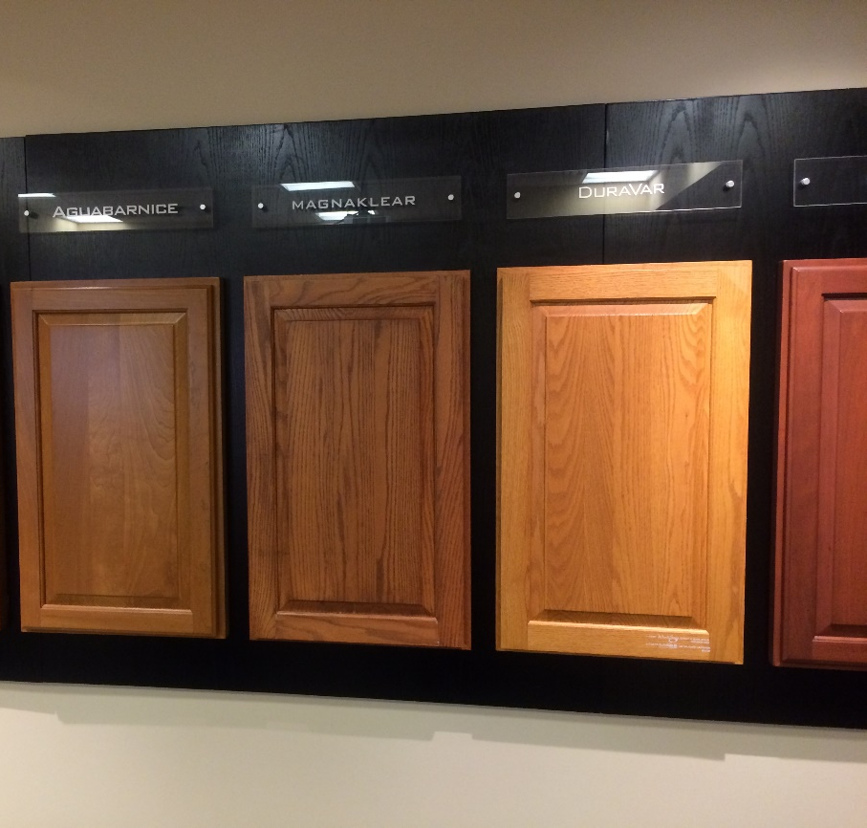
Steps of Wood Finishing
A Clear and Stain Finish System
  Sand
  Stain
  Sealer
  Sand
  Shade and or Glaze (optional)
  Topcoat
  Sand
  Topcoat

Slide 3
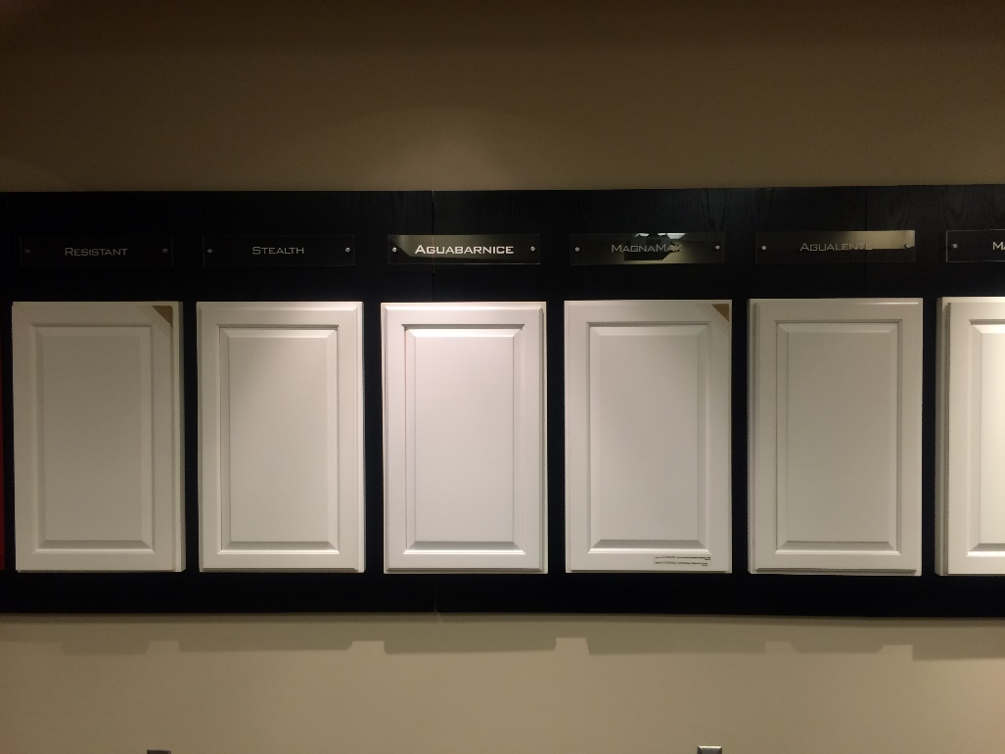
Steps of Wood Finishing
A Typical Pigmented System
  Sand
  Primer / Sealer
  Sand
  Topcoat
  Sand
  Topcoat

Slide 4
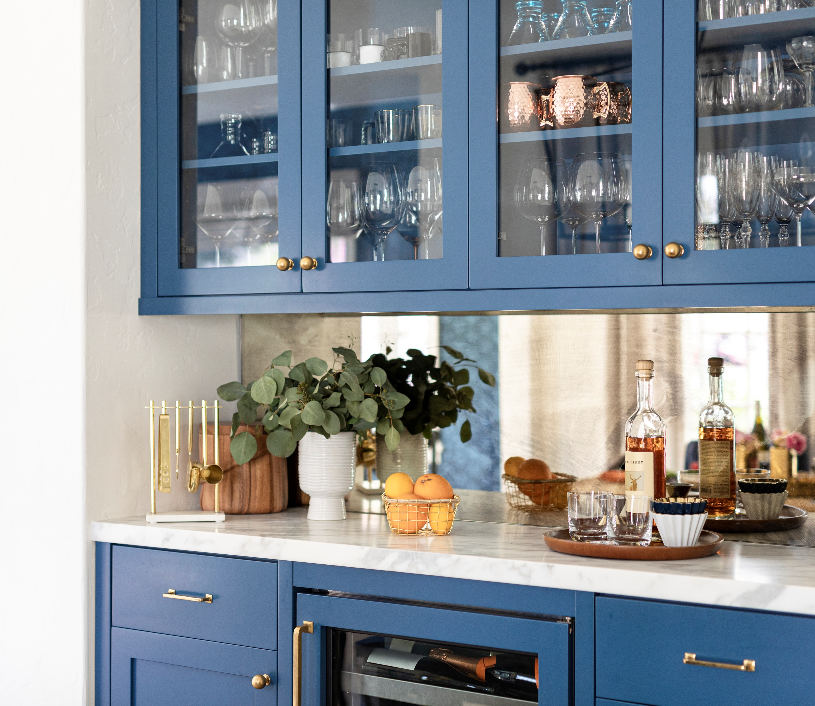
Steps of Wood Finishing
Choose a Coating System
  Clear or Pigmented
  Stain or Natural under a Clear?
  To Glaze, or Not to Glaze?
  What Level of Durability
  What Price Point
  Environmental Considerations – HAP’s VOC’s
  Application Considerations
    Minimum Application Temperature
    Special Equipment Required
    Dust and Airborne Debris

Slide 5
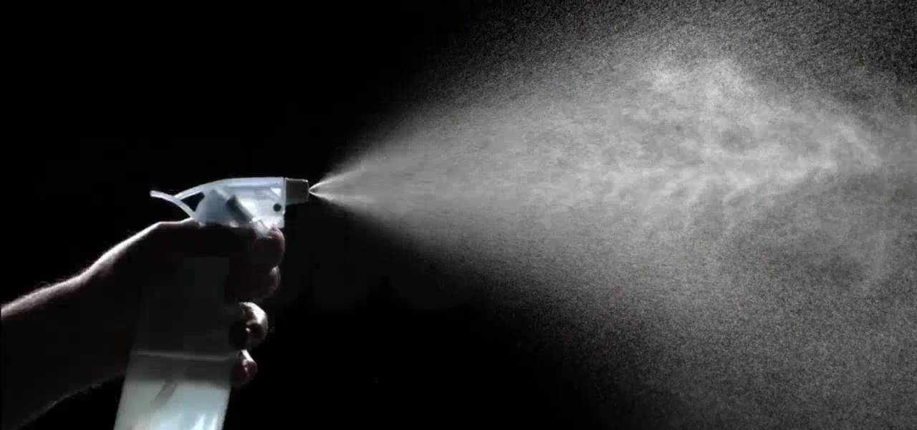
Steps of Wood Finishing
Atomization

Slide 6
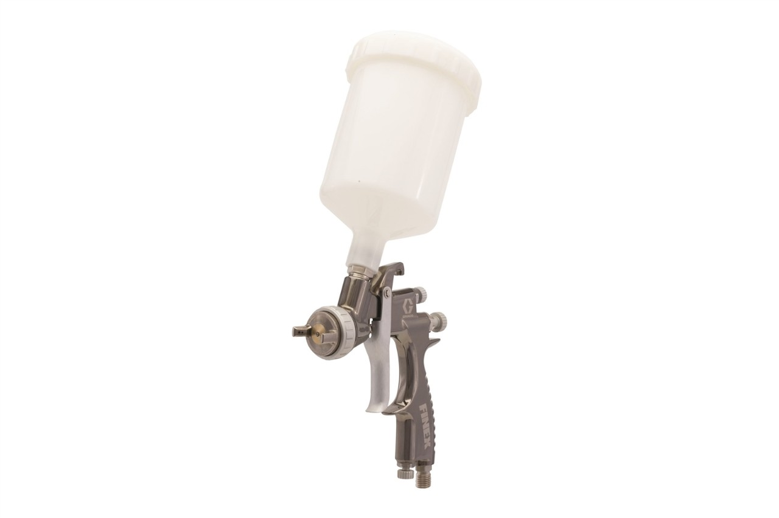
Steps of Wood Finishing
How do we Atomize a Coating?
  Conventional Air Spray - (Cup, Pump or Pressure Pot)
  HVLP Air Spray - (Cup, Pump or Pressure Pot)
  Compliant Air Spray - (Cup, Pump or Pressure Pot)
  HVLP Turbine
  Air Assisted Airless (HVLP or Not)

Slide 7
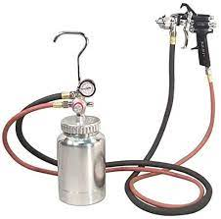
Steps of Wood Finishing
How do we Atomize a Coating?
  Airless
  Electrostatic
  Roll Coater
  Curtain Coater
  Flow Coater
  Vacuum Coater
  Automated Application Devises and Robots

Slide 8
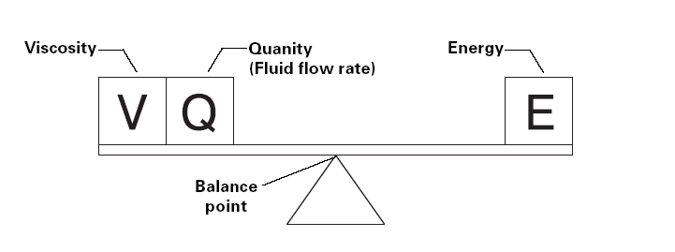
Steps of Wood Finishing
How do we Atomize a Coating?
  Fluid Tip Size
    Thicker the material, the bigger the tip
    The bigger the tip, the greater the flow rate
  Operating Pressure(s) - Energy
    Thicker the material the higher the energy required for atomization
  Flow Rate
    Greater flow requires more energy

Slide 9
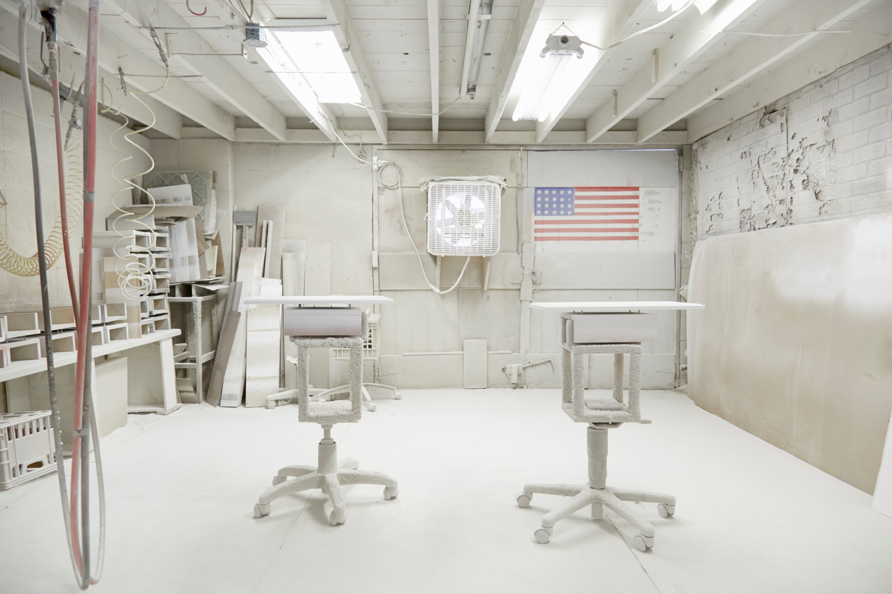
Steps of Wood Finishing
Setting Up a Spray Environment
  Spray Booth
  Air Make Up System
  Dust Control
  Environmental Controls (Heat and AC)
  Compressed Air System
    Adequate Volume?
    Clean?
    Dry?

Slide 10
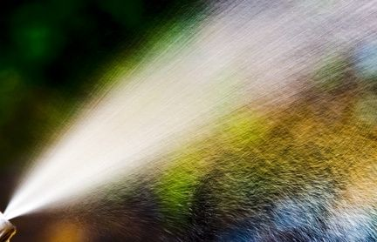
Components of a Coating

Slide 11
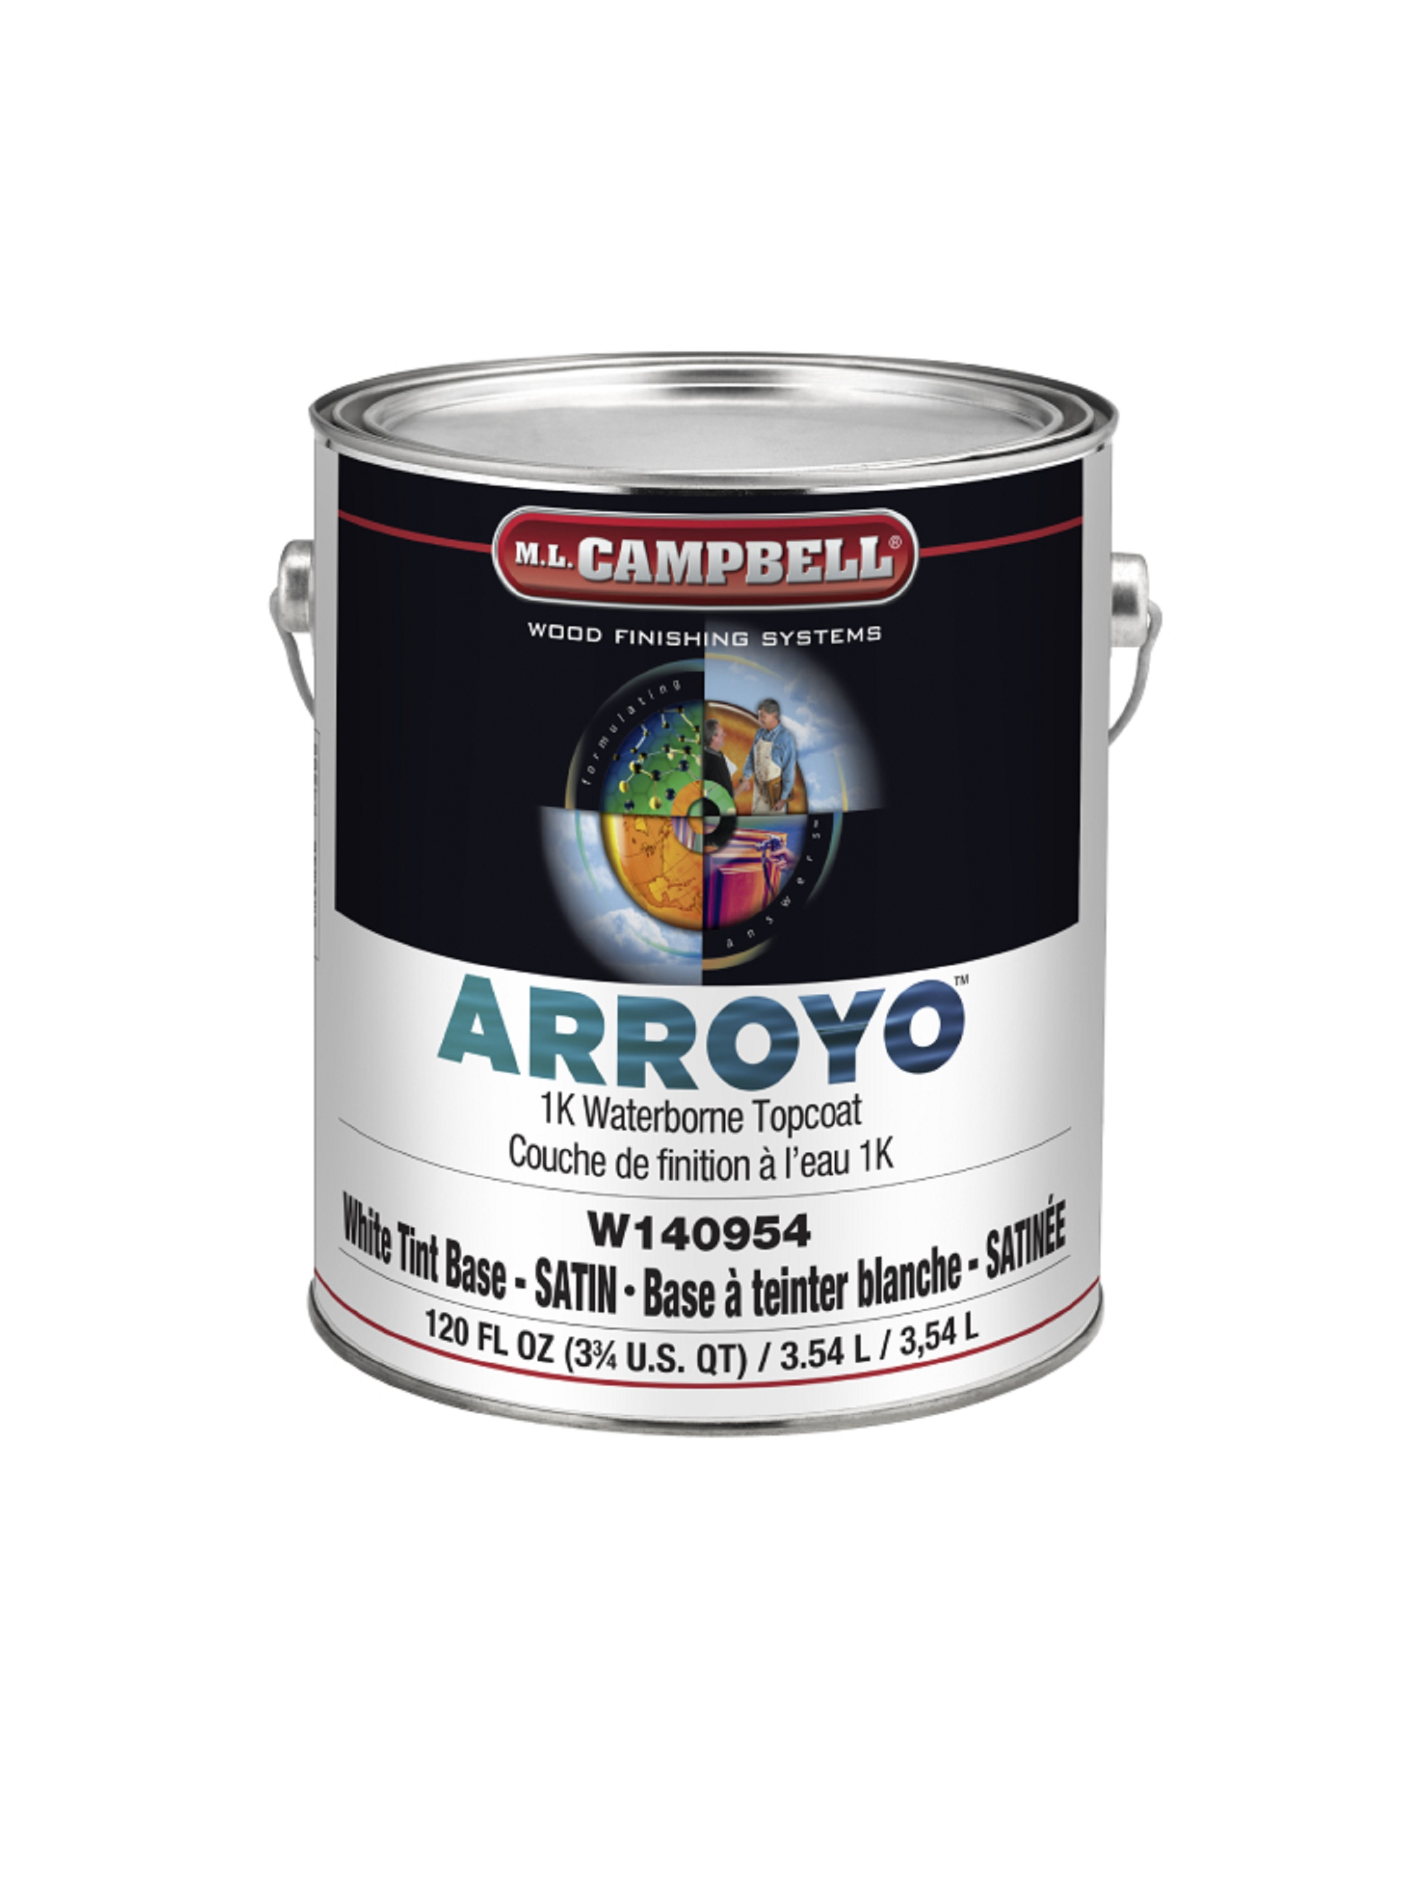
What’s in a Can?
Resin
  Alkyd, Amino, Acrylic, Polyester, Epoxy, Urethane, Vinyl, Nitrocellulose
Pigment
  Titanium Dioxide, Industrial Colorants
Additives and Extenders
  Calcium Carbonate, Talc, Micronized Silica, Wax
Solvent
  Dissolves resins and reduces viscosity
  Solvent is many different chemicals
  Controls flow, level and dry
  Evaporates out of the coating

Slide 12
Solvent vs. Water Borne

Slide 13
Wet Film Build

Slide 14
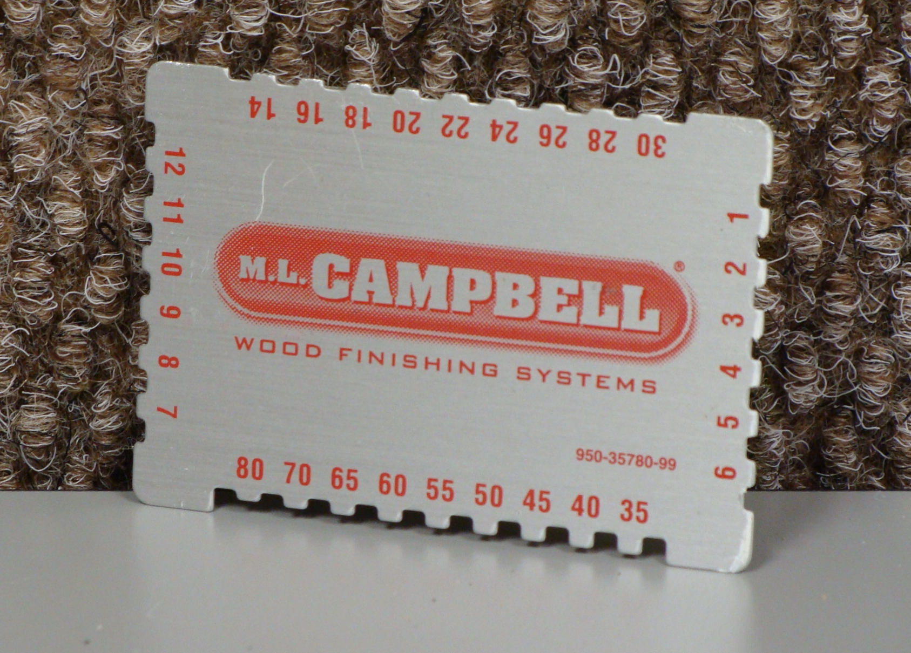
Wet Film Build

Slide 15
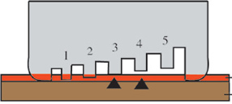
Wet Film Build
Coating
Substrate
Typical wood coating application – 3 to 5 wet mils

Slide 16
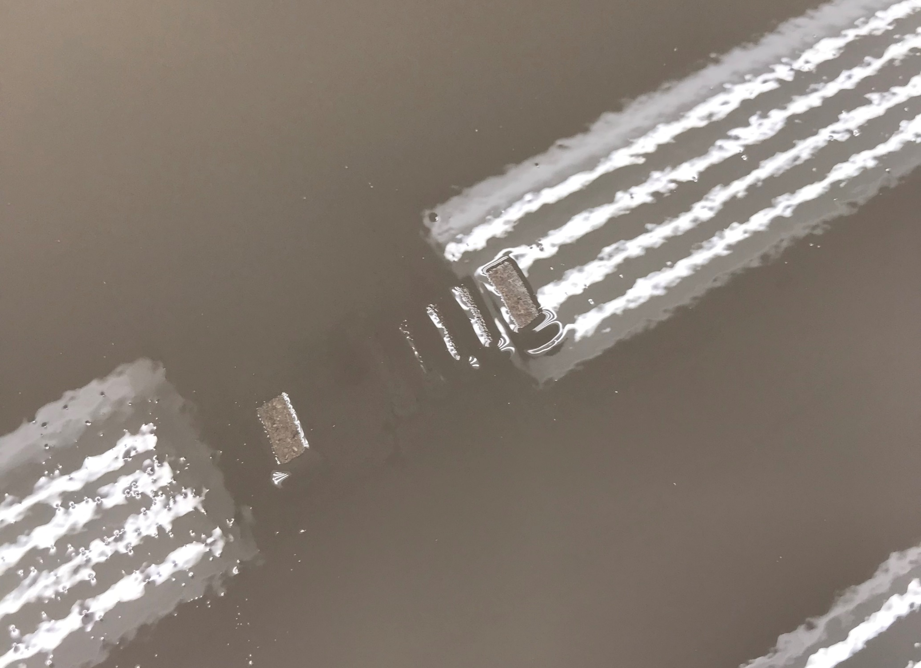
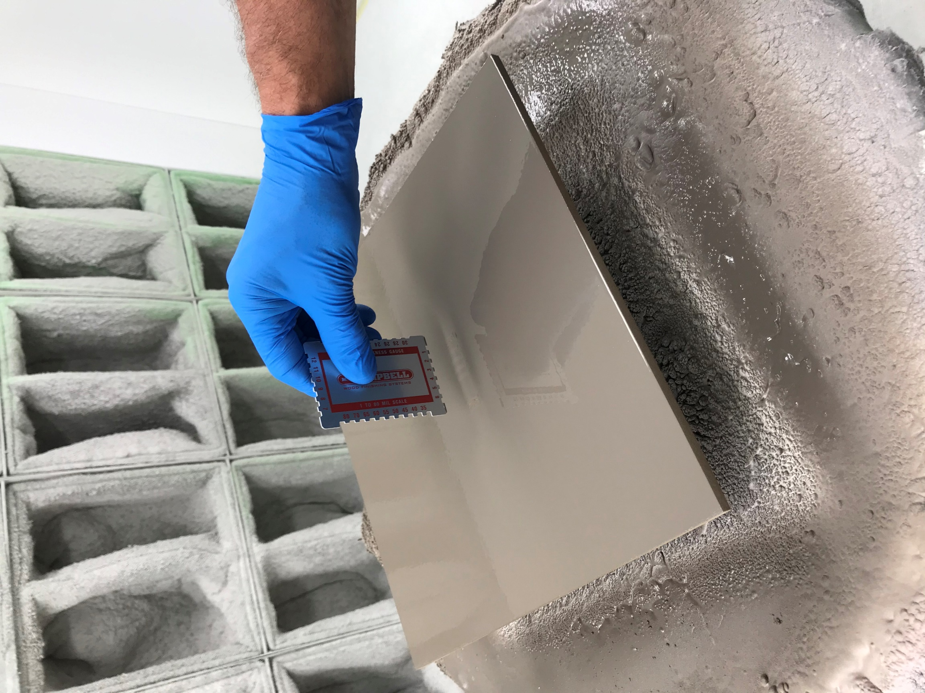
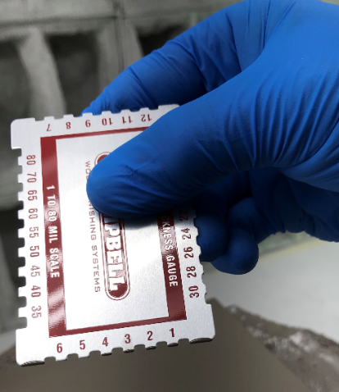
Wet Film Build

Slide 17
Dry Film Build

Slide 18
Dry Film Build
Volume and Weight Solids
128 Fluid Ounces
Solid Portion of a coating contains all film forming components
Volatile or solvent portion is a vehicle to carry film formers and does not remain in the film
Solid portion is typically heavier than the solvent portion
Solvent Portion
50% VV
40% WV
64 Fluid Ounces
Solid Portion
50% VS
60% WS
64 Fluid Ounces

Slide 19
Dry Film Build
Resin (Solids)
  Alkyd, Amino, Acrylic, Polyester, Epoxy, Urethane, Vinyl, Nitrocellulose
Pigment (Solids)
  Titanium Dioxide, Industrial Colorants
Additives and Extenders (Solids)
  Calcium Carbonate, Talc, Micronized Silica, Wax
Solvent
  Dissolves resins and reduces viscosity
  Solvent is many different chemicals
  Controls flow, level and dry
  Evaporates out of the coating

Slide 20
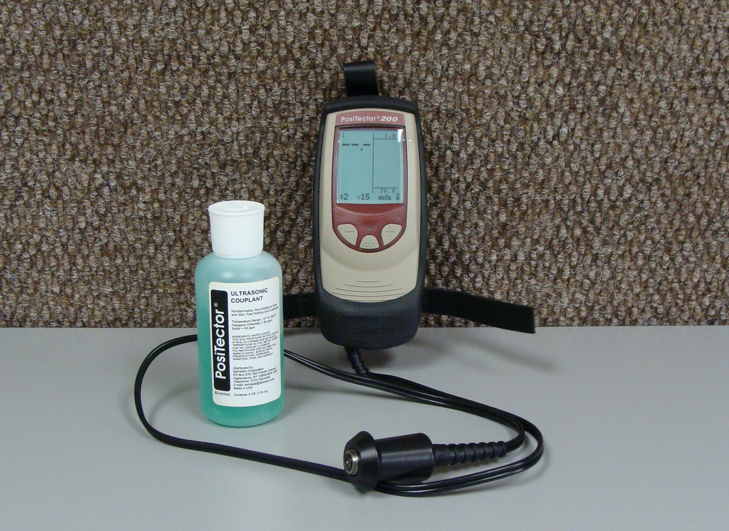
Dry Film Build
Typical wood coating application – 3 to 5 dry mils

Slide 21
Mix Well Before Use

Slide 22
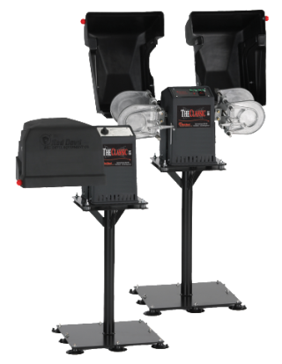
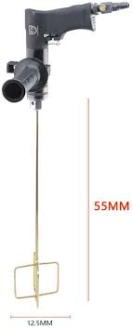
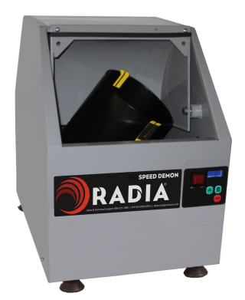
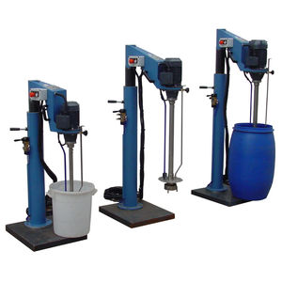
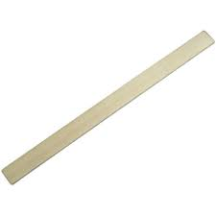
Mix Well

Slide 23
Viscosity

Slide 24

Viscosity
Entrapped Air
Large Wet Particles – Many Air Voids
Resulting in Bubbles

Slide 25

Viscosity
Orange Peel

Slide 26
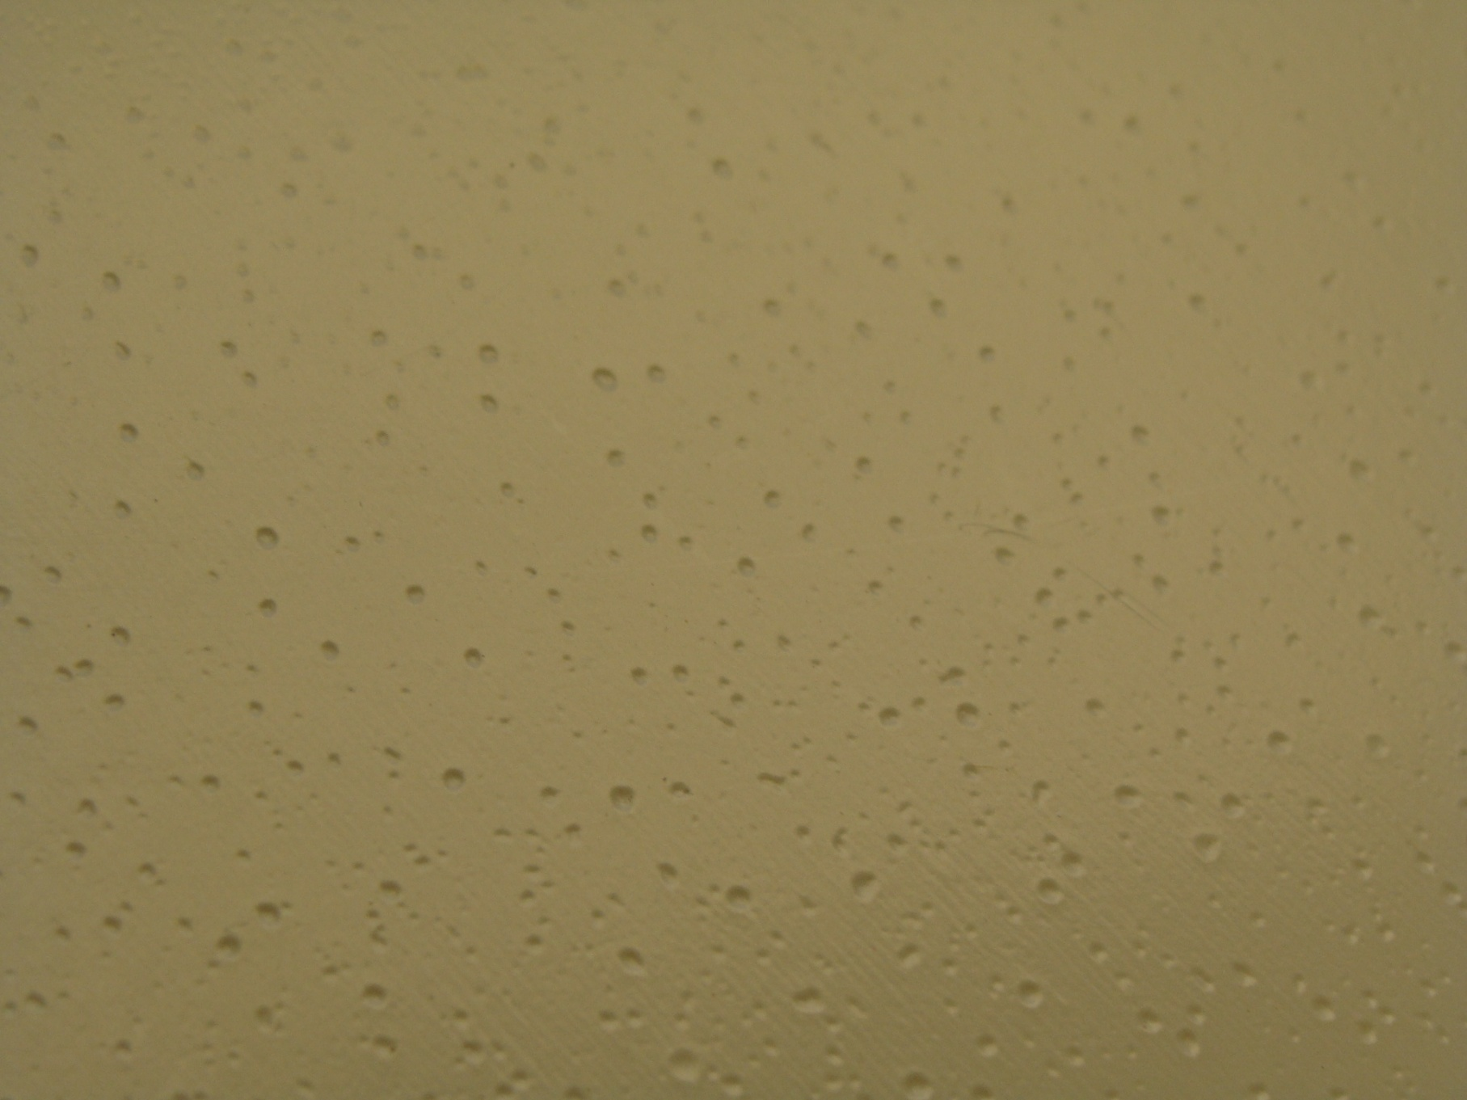
Viscosity
Bubble Cavities

Slide 27
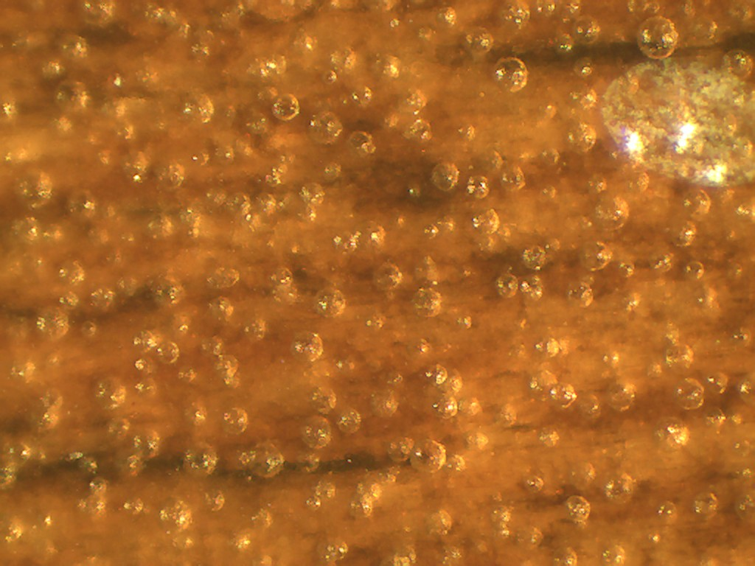
Viscosity
Micro Bubbles

Slide 28
Viscosity
Smaller Wet Particles – Less Entrapped Air
Fewer Bubbles

Slide 29
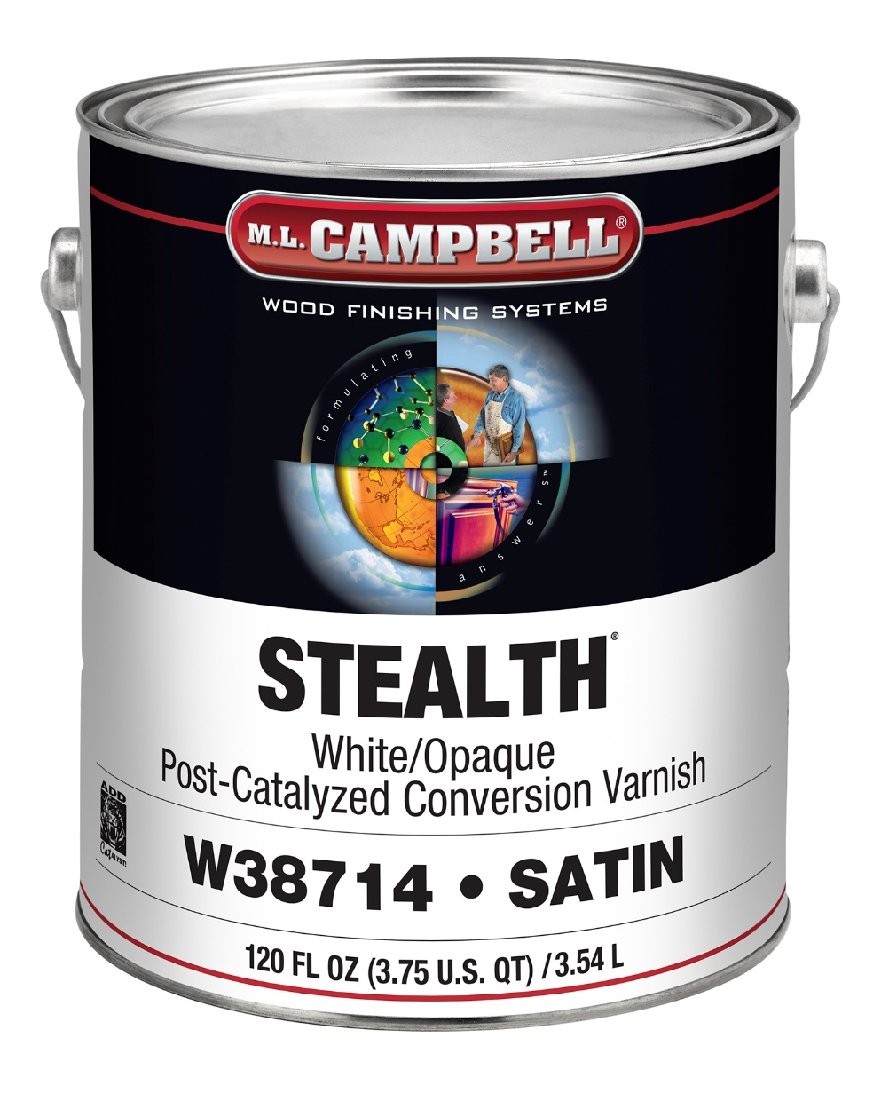
Viscosity
Why don’t we ship all products to the right viscosity?
Pigmented coatings are shipped at high viscosity to prevent settling – reduction is usually required

Slide 30
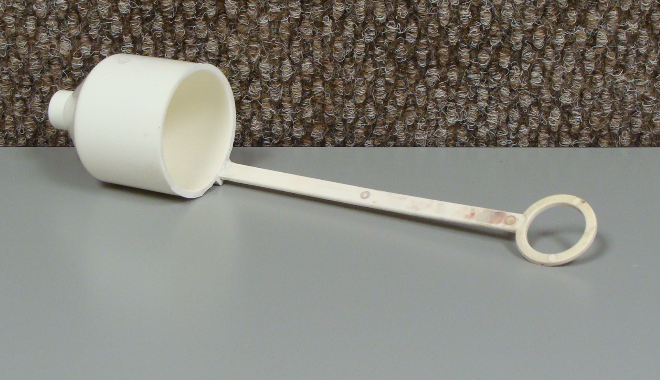
Viscosity
What is the correct viscosity for a product?
Learn to measure viscosity properly.
Good Starting Point – 25” to 30” in a Ford #4

Slide 31
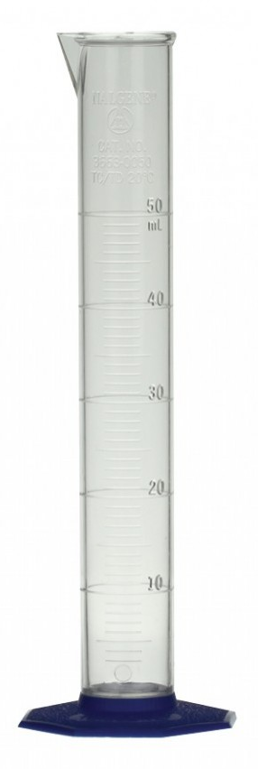
Viscosity
How do you lower viscosity?
Adding solvent will decrease viscosity

Slide 32
Viscosity
Adding Solvent to Lower Viscosity
Before Solvent
After 5% Solvent
Solvent Portion
50% VV
Solvent Portion
52% VV
64 Fluid Ounces
70.4 Fluid Ounces
Solid Portion
Solid Portion
50% VS
48% VS
64 Fluid Ounces
64 Fluid Ounces

Slide 33
Viscosity
How will lowering viscosity affect -
The percentage of solids in a coating?
Flow and leveling?
The dry thickness of a coating?
Open time?

Slide 34
Open Time

Slide 35
Open Time
Wet edge
How long the coating stays wet
Open time to short = poor flow and leveling
Open time adequate = good flow and leveling

Slide 36
What Influences Open Time?
Open Time
Coating formulation
Coating solids
Wet film build
Application equipment
Ambient temperature
Relative humidity
Substrate temperature
Material temperature

Slide 37
Control the Variables
Open Time
Building Engineering Controls
  Ambient temperature and humidity
  Air flow
Automation
  Automated sprayers control wet film thickness
  Standardize application equipment – pumps – spray heads
Force Drying
  IR pre-heaters control substrate temperature
  In-line fluid heaters control coating temperature
  Force drying systems control flash-off, drying and curing temperatures
  Influences dry to touch, sand and stack times

Slide 38
Open Time
How do you increase open time?
Which one do you use?
Why not different coatings for different climates?

Slide 39
Open Time
Adding Solvent to Increase Open Time
Before Solvent
After 5% Solvent
Solvent Portion
50% VV
Solvent Portion
52% VV
64 Fluid Ounces
70.4 Fluid Ounces
Solid Portion
Solid Portion
50% VS
48% VS
64 Fluid Ounces
64 Fluid Ounces

Slide 40
Open Time & Viscosity
Adding Solvent to Increase Open Time & Viscosity
Before Solvent
After 5% Thinner & 5% Retarder
Solvent Portion
50% VV
Solvent Portion
54% VV
64 Fluid Ounces
76.8 Fluid Ounces
Solid Portion
50% VS
Solid Portion
46% VS
64 Fluid Ounces
64 Fluid Ounces

Slide 41
Grain Raise

Slide 42
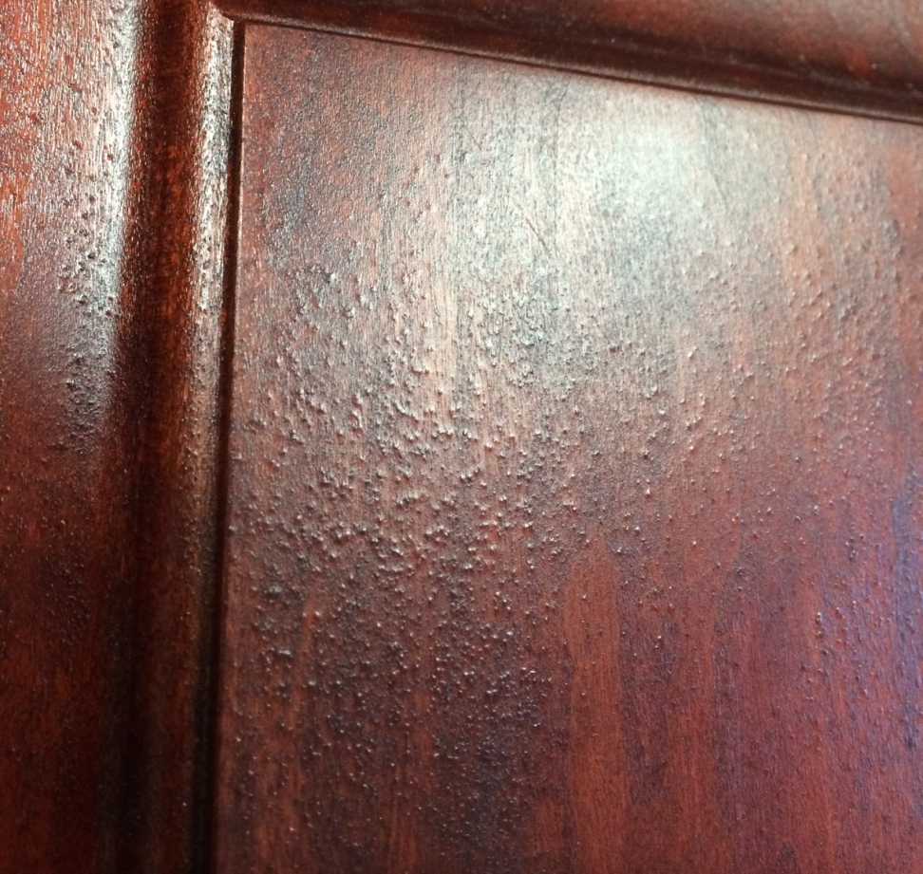
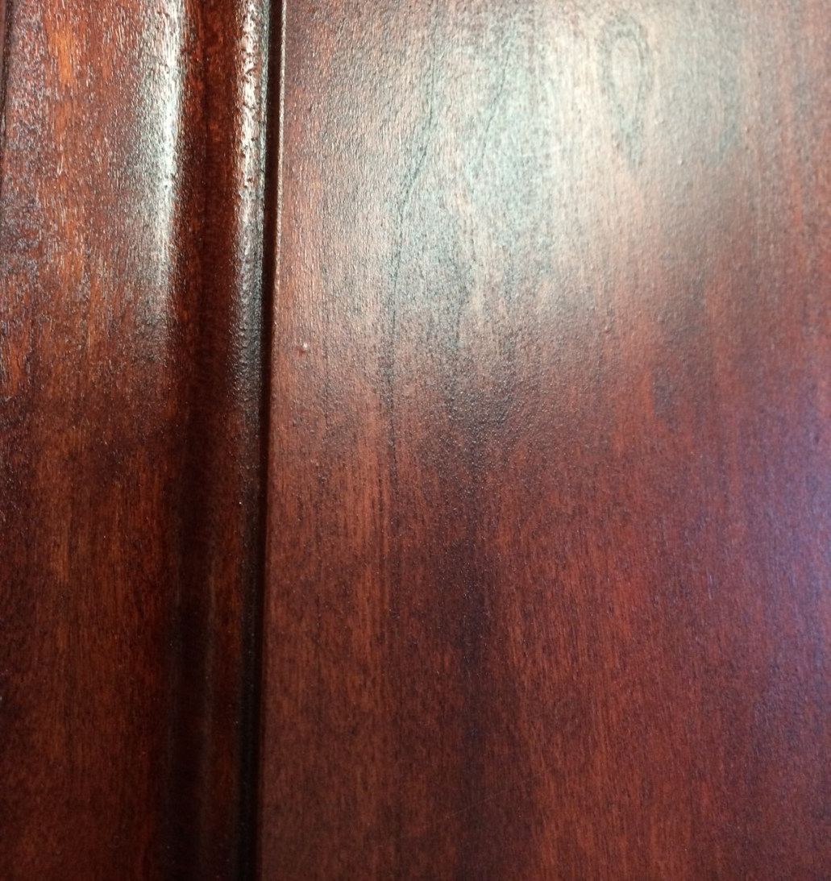
Grain Raise
Reaction of wood to water
Wood fibers on the surface swell and rise up when saturated with water
Not as pronounced with solvent borne coatings
How can we avoid it?

Slide 43
VOC

Slide 44
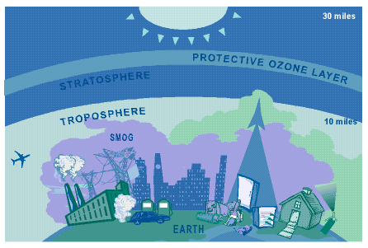
VOC + NOx + Heat + Sunlight = Ozone
http://www.epa.gov/oar/oaqps/gooduphigh/chartsn.gif

Slide 45
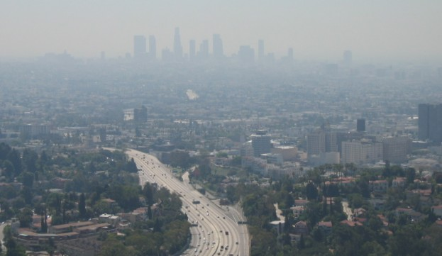
Federal Regulations
Congress created the 1970 Clean Air Act (CAA)
This act authorized the EPA to regulate VOC emissions on specific industries
For example – A certain area of the country may limit the VOC content of a coating to 670 grams/liter

Slide 46
NC Lacquer
WPG 7.60 lbs/gal
17% Vol. Solids
83% Solvent
Solvent
VOC Content
725 grams/liter
5.75 lbs/gallon
EPA Reg.
670 grams/liter
5.60 lbs/gallon
Solids

Slide 47
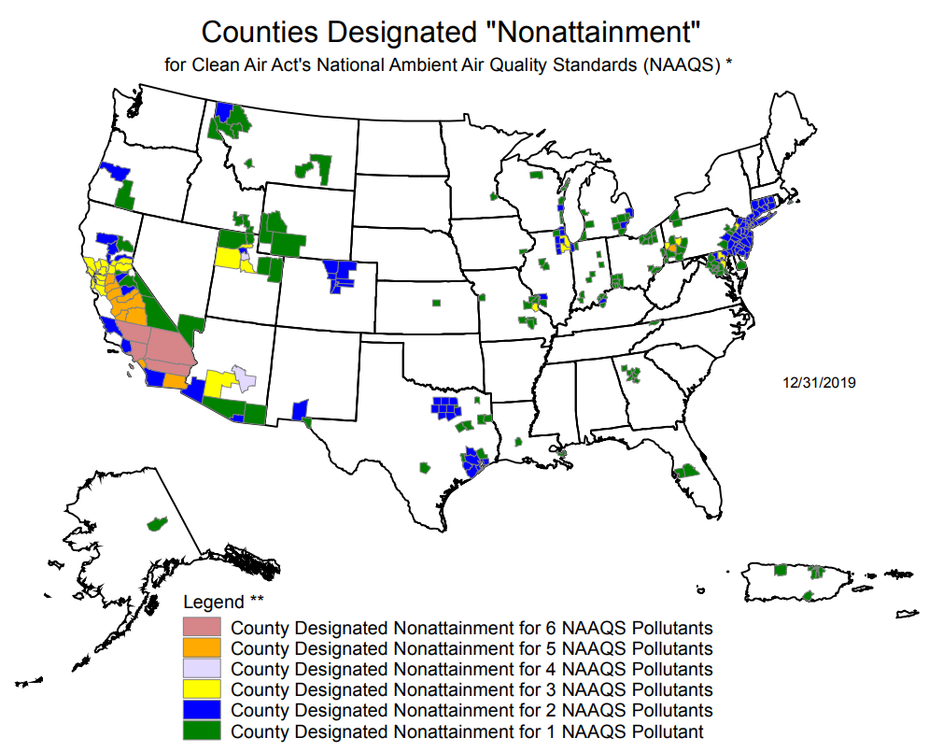
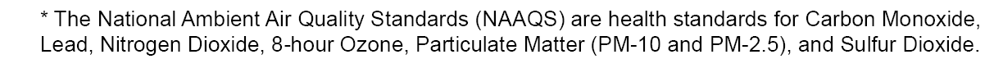

Slide 48
KlearVar
WPG 7.91 lbs/gal
32% Vol. Solids
68% Solvent
Solvent
VOC Content
551 grams/liter
4.6 lbs/gallon
EPA Reg.
670 grams/liter
5.60 lbs/gallon
Solids

Slide 49
HAP’s

Slide 50
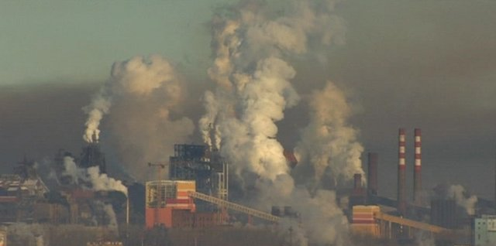
Federal Regulations
Congress created the 1970 Clean Air Act (CAA)
Congress amended the CAA in 1990 to include 189 HAP’s
This act authorized the EPA to regulate HAP’s emissions on specific industries

Slide 51
189 Hazardous Air Pollutants

Slide 52
189 Hazardous Air Pollutants

Slide 53
Any Brand Lacquer
Toluene – Xylene - MEK
Solvent
HAPs Content
Solvents
Solids
Dibutyl Phthalate
Solids

Slide 54
Green Organizations

Slide 55


Slide 56
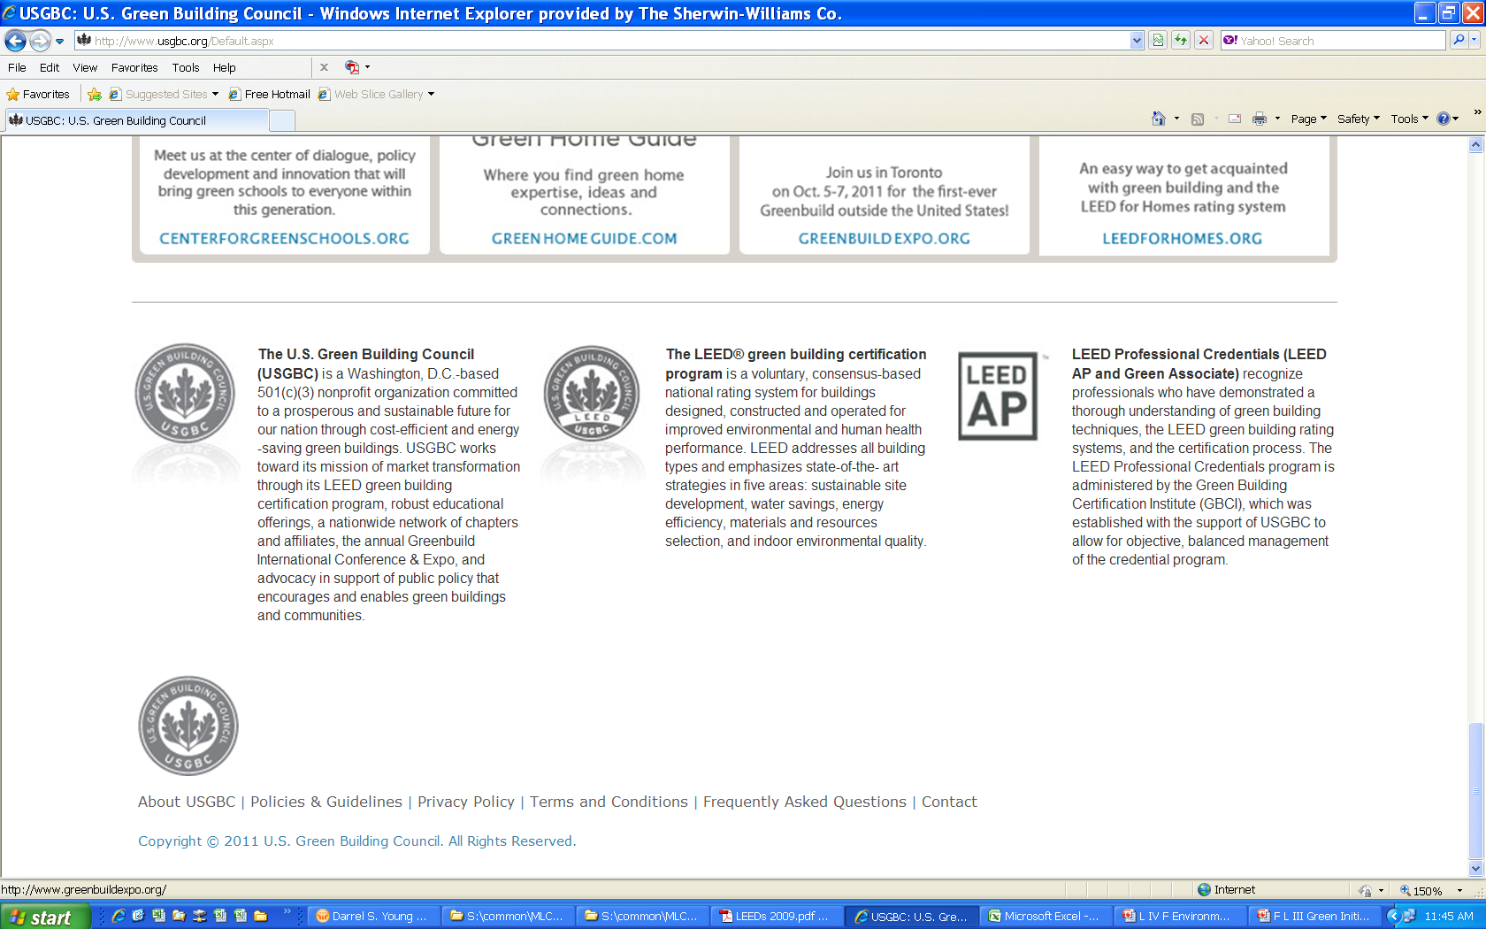


Slide 57
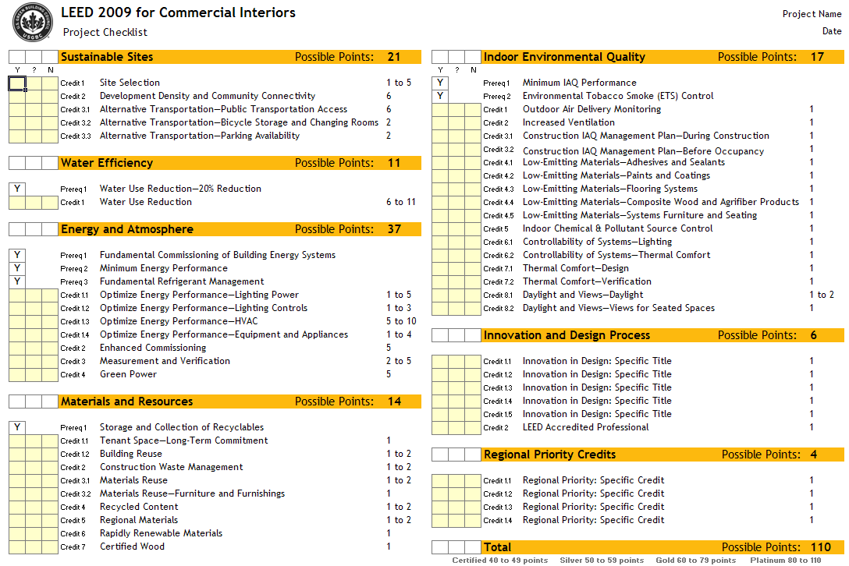

Slide 58
WWW.MLCAMPBELL.COM
Darrel Young
Training Manager
ML Campbell Wood Finishing Systems
darrel.s.young@mlcampbell.com

